Slide 1
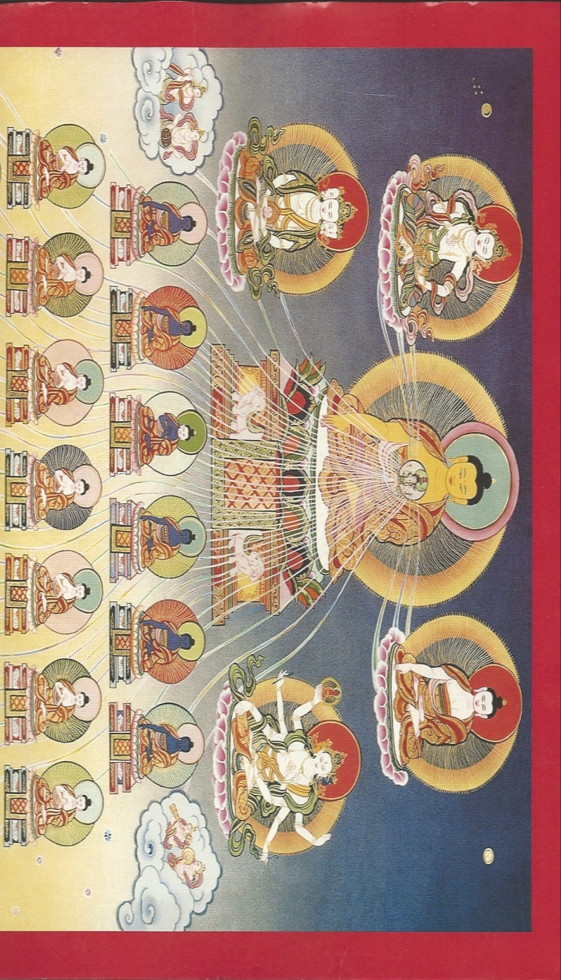
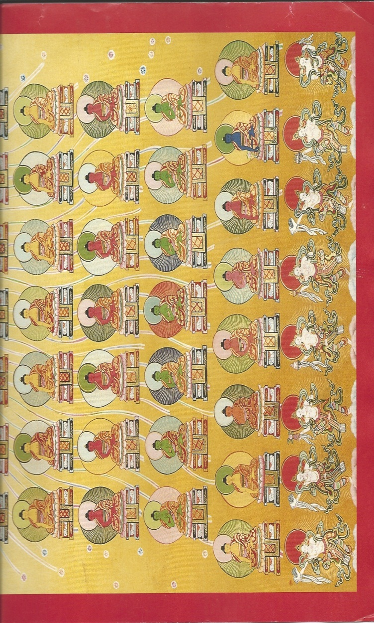

Slide 2
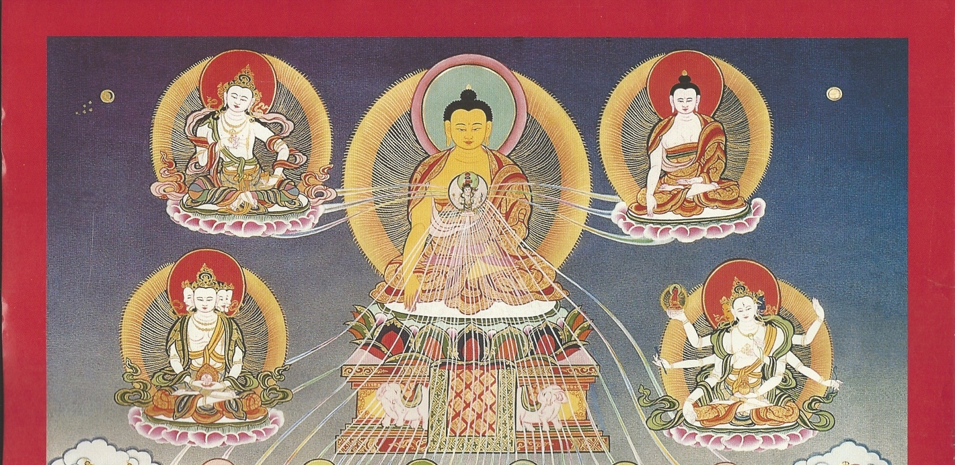
1. Shakyamuni
To the founder, bhagavan, tathagata, arhat, completely perfected completed buddha, Glorious Conqueror Shakyamuni Buddha

Slide 3

2. VAJRA (GARBHA) PRAMARDI
Thoroughly Destroying with Vajra Essence

Slide 4

3. RATNARCIS
Radiant Jewel

Slide 5
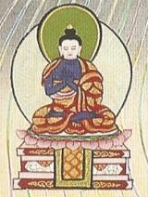
4. NAGESVARA RAJA
King, Lord of the Nagas

Slide 6
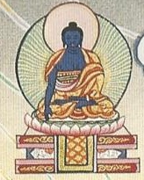
5. VIRASENA
Army of Heroes

Slide 7

6. VIRANANDI
Delighted Hero

Slide 8
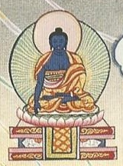
7. RATNAGNI
Jewel Fire

Slide 9
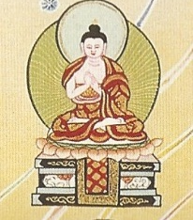
8. RATNA CANDRA PRABHA
Jewel Moonlight

Slide 10
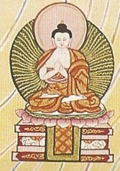
9. AMOGHA DARSIN
Meaningful to See

Slide 11
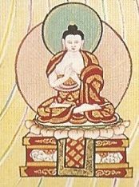
10. RATNA CANDRA
Jewel Moon

Slide 12
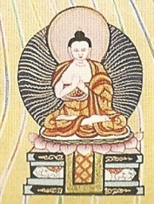
11. VIMALA
Stainless One

Slide 13
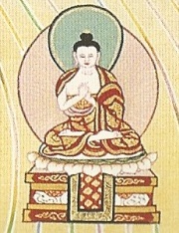
12. SURA DATTA
Bestowed with Courage

Slide 14
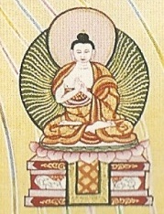
13. BRAHMA
(The) Pure One

Slide 15
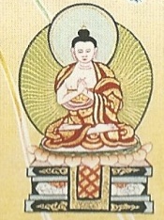
14. BRAHMADATTA
Bestowed with Purity

Slide 16
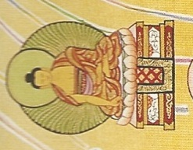
15. VARUNA
Water God

Slide 17
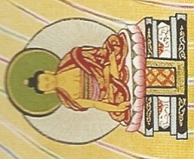
16.VARUNADEVA
Deity of the Water God

Slide 18

17. SRIBHADRA
Glorious Goodness

Slide 19
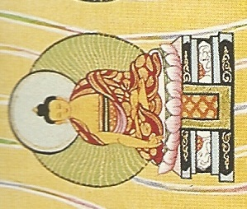
18. CANDANASRI
Glorious Sandalwood

Slide 20

19. ANANTA TEJAS
Infinite Splendour

Slide 21

20. PRABHASA SRI
Glorious Light

Slide 22
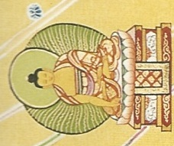
21. ASOKASRI
Glorious without suffering

Slide 23

22. NARAYANA
Son of non-craving (son without desire)

Slide 24

23. KUSUMASRI
Glorious Flower

Slide 25

24. BRAHMA-JYOTI-VIKRI-DITA-BHIJNA
Pure Light Rays Clearly Knowing by Play

Slide 26

25. PADMA-JYOTI-VIKRI-DITA-BHIJNA
Lotus Light Rays Clearly Knowing by Play

Slide 27

26. DHANASRI
Glorious wealth

Slide 28

27. SMRITISRI
Glorious One Who Is Mindful

Slide 29

28. SUPARI-KIRTI-TANAMA-SRI
Glorious One Whose Name is Extremely Renowned

Slide 30
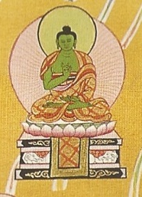
29. INDRA-KETU-DHAVAJA-RAJA
King Holding the Victory Banner of Foremost Power (over the senses)

Slide 31

30. SUVI-KRANTA-SRI
Glorious One Who Vanquishes Utterly Within (totally subduing afflictive emotions & contaminated actions)

Slide 32

31. YUDDHAJAYA
Utterly Victorious in Battles Within (afflictive emotions)

Slide 33

32. VIKRANTA-GAMI-SRI
Glorious One who has Transcended by Vanquishing Within (gone beyond afflictive emotions to perfect self-control)

Slide 34
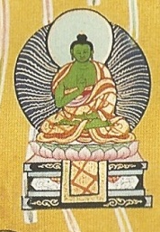
33. SAMANTA-VABHA-SAVYUHA-SRI
Glorious Manifestations Illuminating All (arranges appearances (eliminates ignorance)for all)

Slide 35
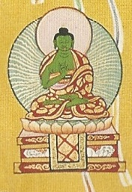
34. RATNA-PADMA-VRIKRAMI
All-Subduing Jewel Lotus

Slide 36

35. RATNA-PADMA-SUPRATISHITA SAILEND-RAJA
Bhagavan, Tathagata, Arhat, Fully Enlightened One, King of the Lord of Mountains, Firmly Seated on Jewel and Lotus

Slide 37
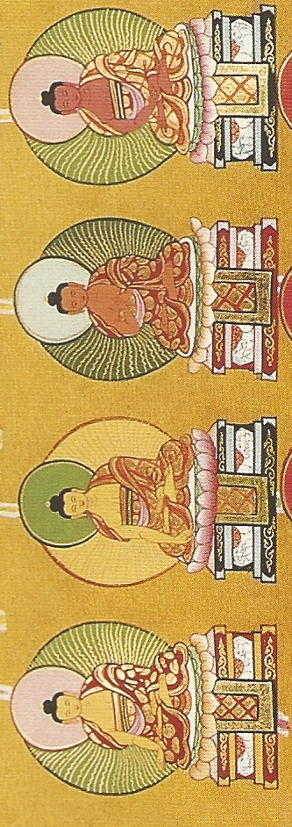
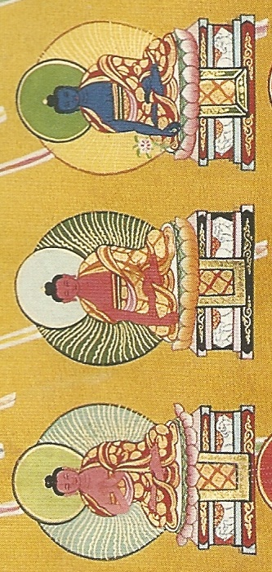

Slide 38

(1) SUPARI KIRTI TANAMA SHRI RAJA
To the bhagavan, tathagata, arhat, perfectly completed buddha, Renowned Glorious King of Excellent Signs, I prostrate.

Slide 39

(2) SVA RAGHOSA RAJA
King of Melodious Sound, Brilliant Radiance of Skill, Adorned with Jewels, Moon, and Lotus.

Slide 40

(3) SUVARNA BHADRA VIMALA RATNA PRABHASA
Stainless Excellent Gold, Illuminating Jewel Who Accomplishes All Conduct.

Slide 41

(4) ASHOK ATAMA SHRI
Glorious Supreme One Free from Sorrow.

Slide 42

(5) DHARMA KIRTI SAGARA GHOSA
Melodious Ocean of Proclaimed Dharma.

Slide 43

(6) ABHIJNARAJA
Clearly Knowing by the Play of Supreme Wisdom of an Ocean of Dharma.

Slide 44

(7) BHAISAJYA GURU VAIDURYA PRABHA RAJA
Medicine Guru, King of Lapis Lazuli Light.

